Slide 1
Statistical Machine Learning
TEXTBOOKS/LEARNING RESOURCES:
a) Masashi Sugiyama, Introduction to Statistical Machine Learning (1st ed.), Morgan Kaufmann, 2017. ISBN 978-0128021217.
b) T. M. Mitchell, Machine Learning (1st ed.), McGraw Hill, 2017. ISBN 978-1259096952.
REFERENCE BOOKS/LEARNING RESOURCES:
a) Richard Golden, Statistical Machine Learning A Unified Framework (1st ed.), unknown, 2020.

Slide 2
Lecture -
Bias and Variance
Overfitting Underfitting
Cross Validation

Slide 3
Bias vs Variance
Bias vs Variance

Slide 4
Bias vs Variance
Bias vs Variance
The goal of any supervised machine learning algorithm is to
best estimate the mapping function (f) for the output variable (Y) given the input data (X)
However, their still exist prediction error, which is due to:
Irreducible Error
Bias Error
Variance Error
Error = Bias error + Variance error + Irreducible error.

Slide 5
Bias vs Variance
Irreducible Error
The irreducible error cannot be reduced regardless of what algorithm is used. It is the error introduced from the chosen framing of the problem and may be caused by factors like unknown variables that influence the mapping of the input variables to the output variable.
For example:
Random Noise

Slide 6
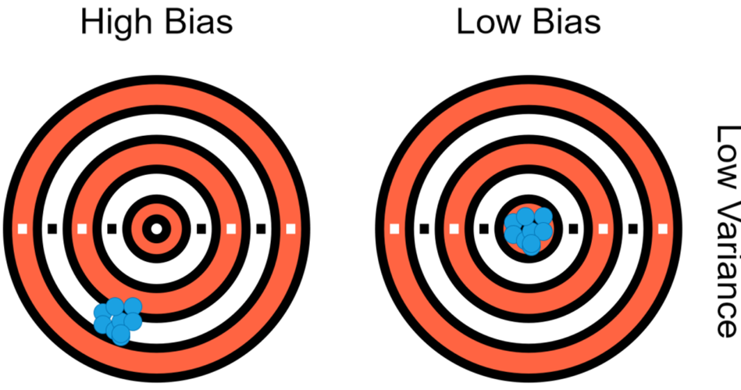
Bias vs Variance
Bias Error
Bias is the difference between the average prediction of our model and the correct value which we are trying to predict.
Model with high bias pays very little attention to the training data and oversimplifies the model.
It always leads to high error on training and test data.
Truth
Underfitting

Slide 7
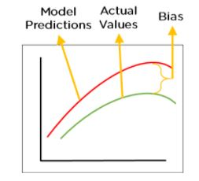
Bias vs Variance
Bias Error
Bias is the difference between our actual and predicted values. Bias is the simple assumptions that our model makes about our data to be able to predict new data
When the Bias is high, assumptions made by our model are too basic, the model can’t capture the important features of our data. This means that our model hasn’t captured patterns in the training data and hence cannot perform well on the testing data too. If this is the case, our model cannot perform on new data and cannot be sent into production.

Slide 8
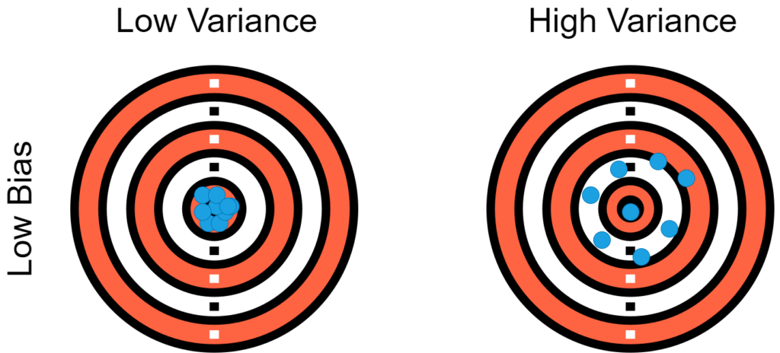
Bias vs Variance
Variance Error
Variance is the variability of model prediction for a given data point.
Model with high variance pays a lot of attention to training data and does not generalize on the test data which it hasn’t seen before. As a result, such models perform very well on training data but has high error rates on test data
Overfitting

Slide 9
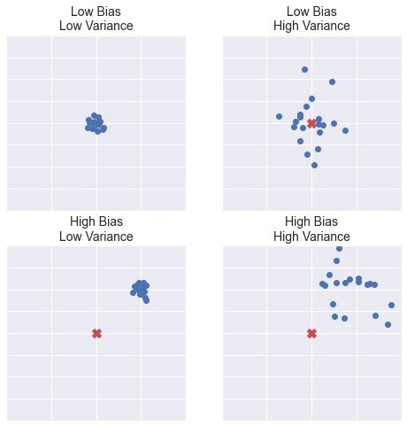
Bias vs Variance
Bias vs Variance
low bias, low variance — is a good result, just right.
low bias, high variance — overfitting — the algorithm outputs very different predictions for similar data
high bias, high variance — very bad algorithm. You will most likely never see this.
high bias, low variance — underfitting — the algorithm outputs similar predictions for similar data, but predictions are wrong (algorithm “miss”).

Slide 10
Bias vs Variance
Bias vs Variance
Low Bias: Suggests less assumptions about the form of the target function.
High-Bias: Suggests more assumptions about the form of the target function.
Examples of low-bias : Decision Trees, k-Nearest Neighbors and Support Vector Machines.
Examples of high-bias : Linear Regression, Linear Discriminant Analysis and Logistic Regression.

Slide 11
Bias vs Variance
Bias vs Variance
Low Variance: Suggests small changes to the estimate of the target function with changes to the training dataset.
High Variance: Suggests large changes to the estimate of the target function with changes to the training dataset
Examples of low-variance Linear Regression, Linear Discriminant Analysis and Logistic Regression.
Examples of high-variance Decision Trees, k-Nearest Neighbors and Support Vector Machines.

Slide 12
Bias vs Variance
Bias vs Variance
Bias | Variance
Bias is a phenomenon that occurs in the machine learning model wherein an algorithm is used and it does not fit properly. | Variance specifies the amount of variation that the estimate of the target function will change if different training data was used.
Bias refers to the difference between predicted values and actual values. | Variance says about how much a random variable deviates from its expected value.
The model cannot find patterns in the training dataset and fails for both seen and unseen data. | The model finds most patterns in the dataset and even learns from the unnecessary data or the noise.

Slide 13
Bias vs Variance
Understand Underfitting
Situation when your model is too simple for your data. More formally, your hypothesis about data distribution is wrong and too simple .
For example, your data is quadratic and your model is linear. This situation is also called high bias. This means that your algorithm can do accurate predictions, but the initial assumption about the data is incorrect.

Slide 14
Bias vs Variance
Understand Overfitting
Overfitting is a situation when your model is too complex for your data. More formally, your hypothesis about data distribution is wrong and too complex
For example, your data is linear and your model is high-degree polynomial. This situation is also called high variance.
This means that your algorithm can’t do accurate predictions — changing the input data only a little, the model output changes very much.

Slide 15
Bias vs Variance
What is
the trade-off
??
Model with Bias
Low Training Accuracy
Underfitting
Model with Variance
Overcomplicating simpler problems
Low Testing Accuracy (although have high training accuracy)
Overfitting
Inability to solve complex problems
Very Simple Assumptions
Complex Assumptions

Slide 16
Bias vs Variance
What is
the trade-off
??
Low Bias, Low Variance — is a good result, just right.
Low Bias, High Variance — overfitting — the algorithm outputs very different predictions for similar data
High Bias, High Variance — very bad algorithm. You will most likely never see this.
High Bias, Low Variance — underfitting — the algorithm outputs similar predictions for similar data, but predictions are wrong (algorithm “miss”).

Slide 17
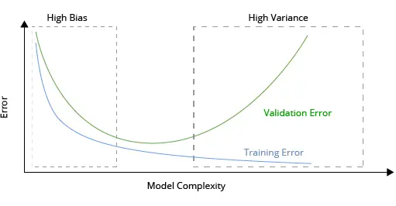
Bias vs Variance
Detection of Bias and Variance of a model
Detection of High Bias:
The model suffers from a very High Training Error.
The Validation error is similar in magnitude to the training error.
The model is underfitting.

Slide 18
Bias vs Variance
Detection of Bias and Variance of a model
Detection of High Variance:
The model suffers from a very Low Training Error.
The Validation error is very high when compared to the training error.
The model is overfitting.

Slide 19
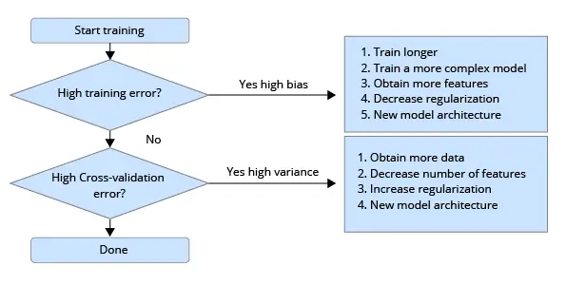
Bias vs Variance
Approach to solve a Bias-Variance

Slide 20
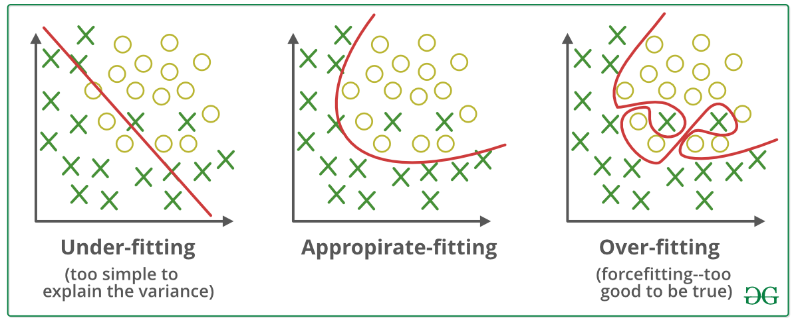
Bias vs Variance
What is
the trade-off
??

Slide 21
Bias vs Variance
Cross Validation

Slide 22
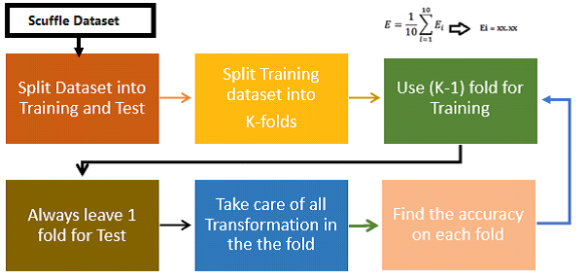
Cross Validation
Life Cycle of K-Fold Cross-Validation
https://www.analyticsvidhya.com/blog/2022/02/k-fold-cross-validation-technique-and-its-essentials/

Slide 23
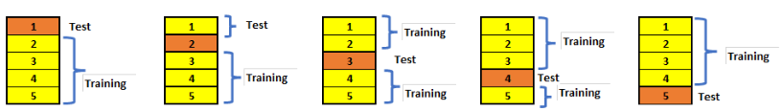
Cross Validation
If K=5, it means, in the given dataset and we are splitting into 5 folds and running the Train and Test.
During each run, one fold is considered for testing and the rest will be for training and moving on with iterations

Slide 24
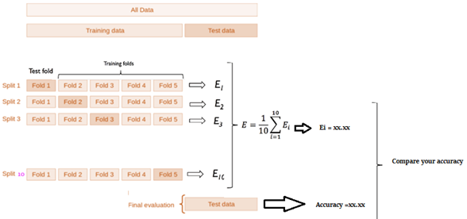
Cross Validation
In which each data point is used, once in the hold-out set and K-1 in Training. So, during the full iteration at least once, one fold will be used for testing and the rest for training.
In the above set, 5- Testing 20 Training. In each iteration, we will get an accuracy score and have to sum them and find the mean.

Slide 25
Bias vs Variance
Thumb Rules Associated with K Fold
K should be always >= 2 and = to number of records, (LOOCV)
If 2 then just 2 iterations and If K=No of records in the dataset, then 1 for testing and n- for training
The number of folds is indirectly proportional to the size of the data set, which means, if the dataset size is too small, the number of folds can increase
If the K value is too large, then this will lead to less variance across the training set and limit the model currency difference across the iterations
Larger values of K eventually increase the running time of the cross-validation process.

Slide 26
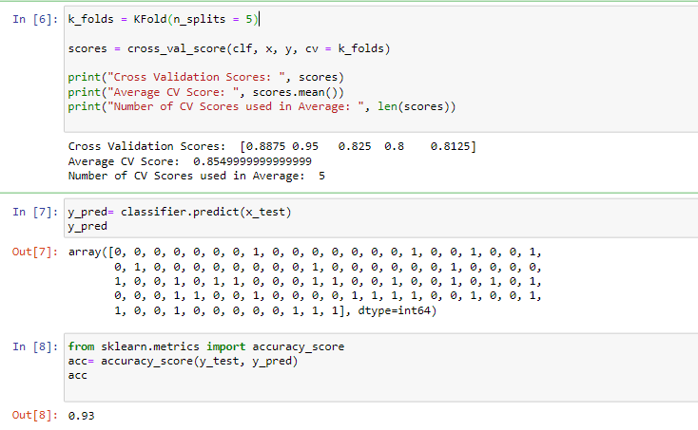
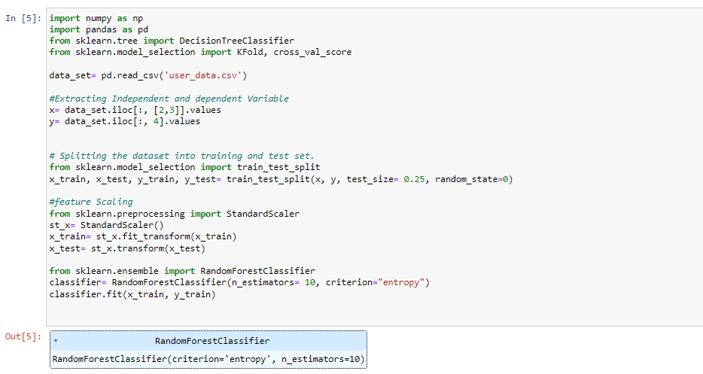
Python Implementation

Slide 27
Further Readings:
Understanding the Bias-Variance Tradeoff, https://towardsdatascience.com/understanding-the-bias-variance-tradeoff-165e6942b229
Everything You Need To Know About Bias And Variance, https://www.simplilearn.com/tutorials/machine-learning-tutorial/bias-and-variance
What is Bias-Variance Tradeoff in Machine Learning, https://www.knowledgehut.com/blog/data-science/bias-variance-tradeoff-in-machine-learning
Cross Validation: https://www.youtube.com/watch?v=QupMZFeyETM

